Slide 1
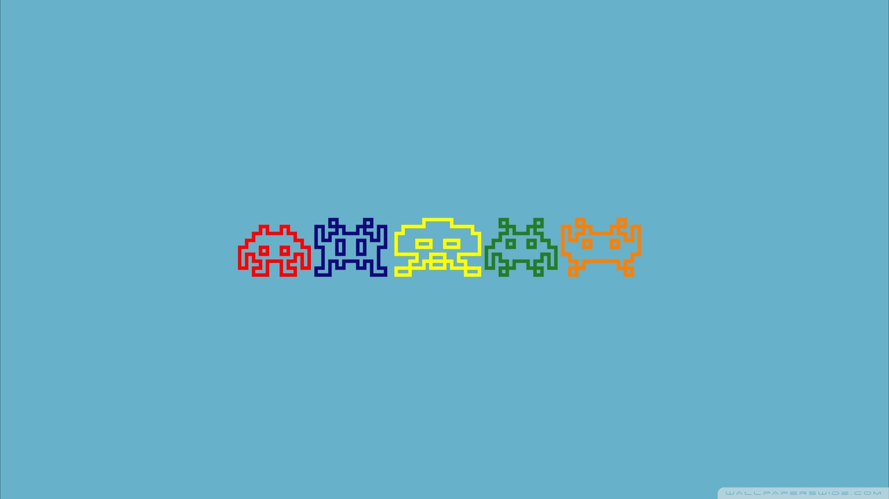
THE «SPACE INVADERS v.23931»
developed by A. Semenov, V. Izhdeneva, E. Maksimov

Slide 2
THE ORIGINAL GAME

Slide 3
THE AIM AND PROBLEMS
The aim of work was to develop a simple version of the popular game «Space Invaders» using functional features of the such platform for developing logical circuits as Logisim and CdM-8 processor.
Before the start of development next goals was chosen as priority.
To analyze the functional features of the original game and choose which of its parts should be in the project.
To study how logical circuits work and how they can be implemented during the development of the game.
To learn more about the way to implement CdM-8 processor into logical circuit.
To do a pretty presentation :).

Slide 4
FUNCTIONAL REQUIREMENTS
Next functional requirements was chosen during the analyzing of the original game.
Player should has ability to control his movements (left-right, right-left).
Player can shoot enemies up.
Enemies move uncontrollably (from right to left and from top to bottom).
Enemies shoot player randomly.
Enemies should disappear when they has been shooted up by player.
Player control the game process by keyboard.
Player can win or lose and restart the game.

Slide 5
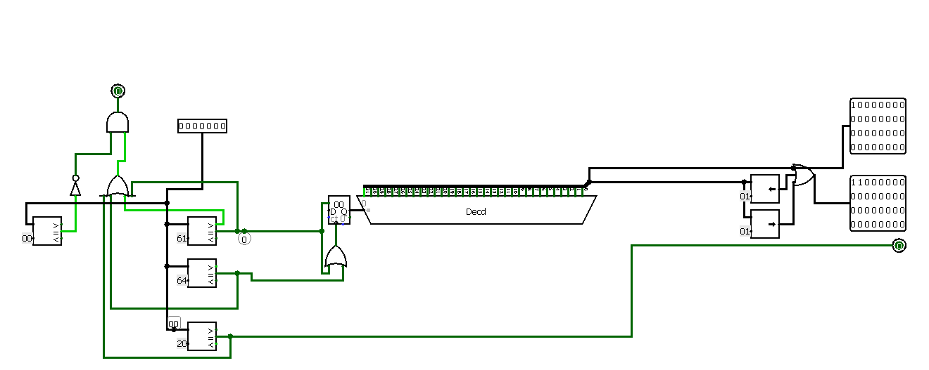
PLAYER MOVEMENT

Slide 6
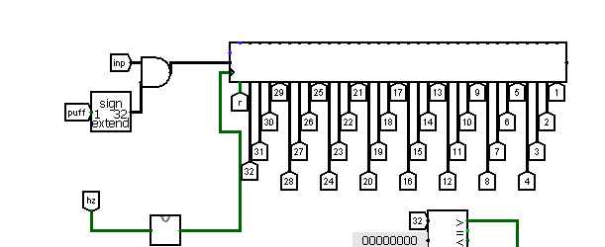
PLAYER SHOOTING

Slide 7
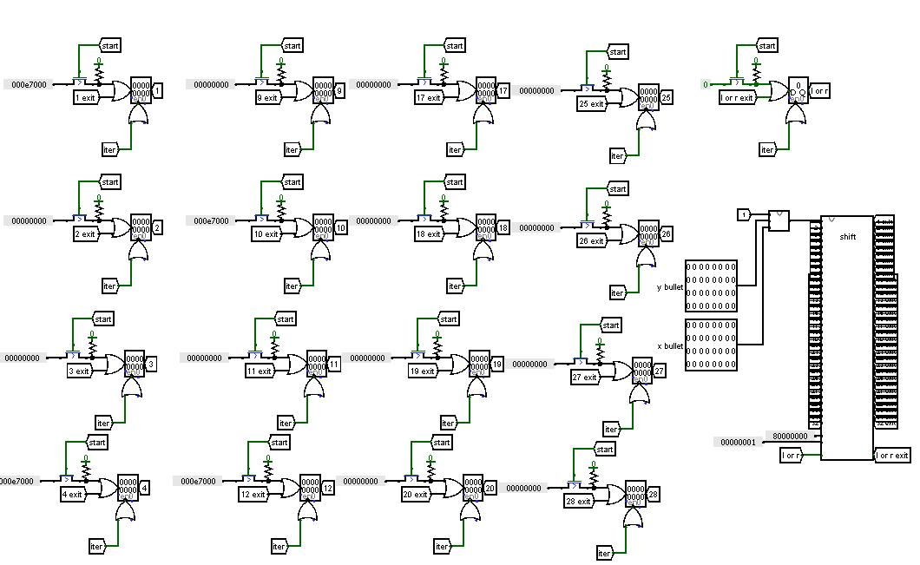
ENEMIES MOVEMENT

Slide 8
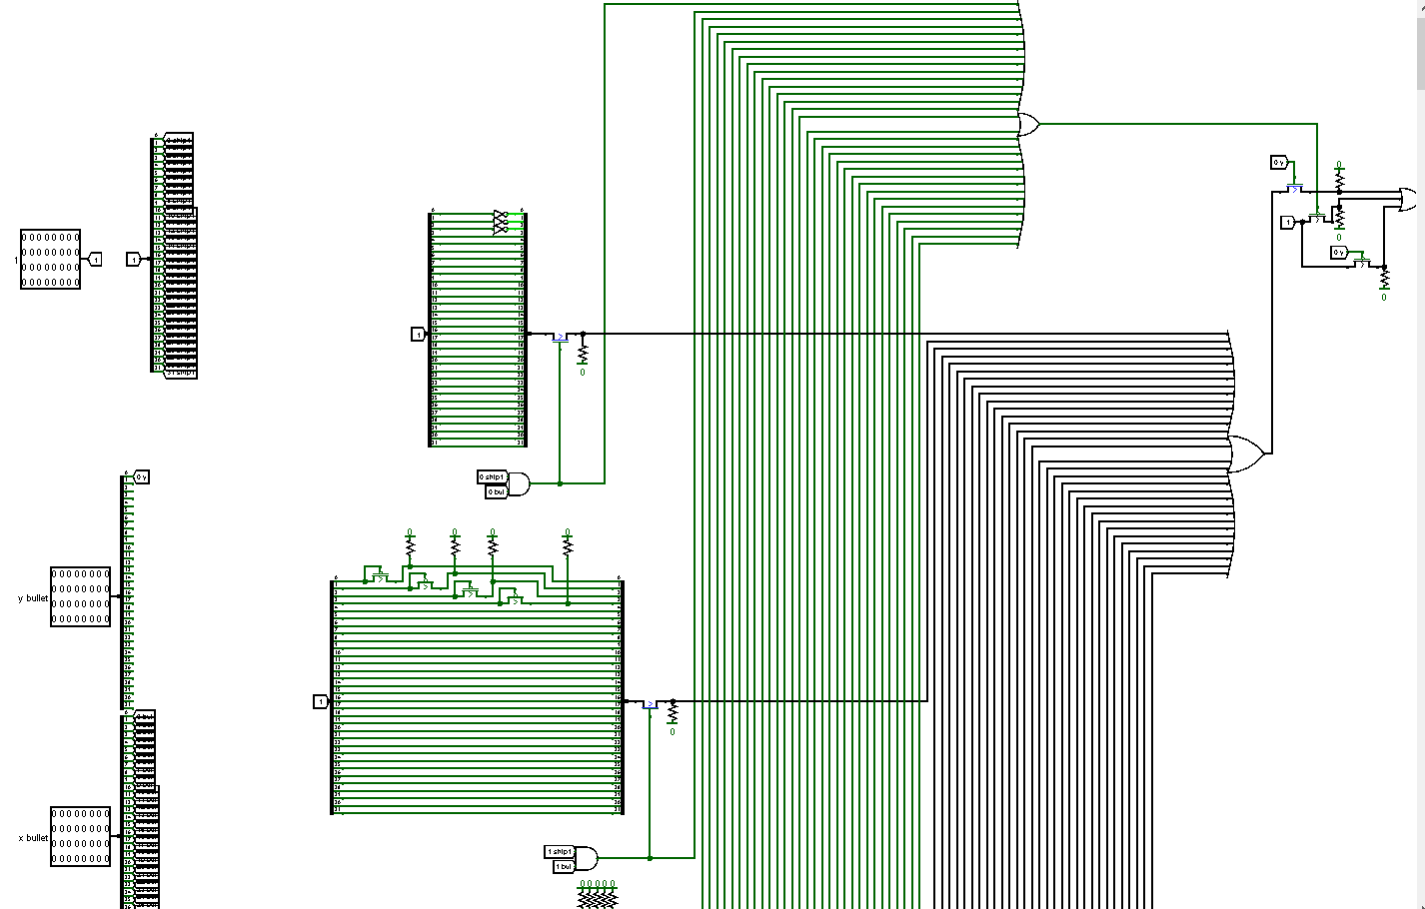
COLLISION

Slide 9
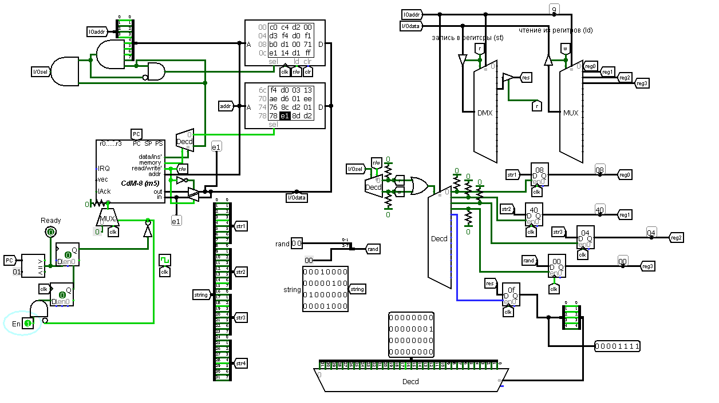
ENEMIES SHOOTING

Slide 10
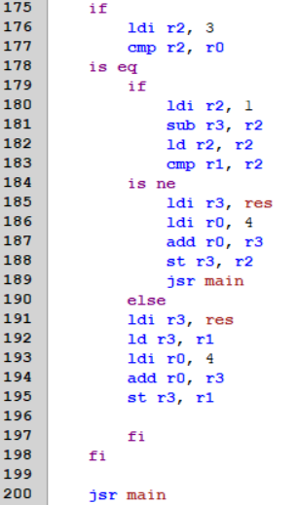
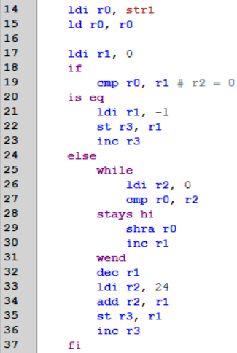
ENEMIES SHOOTING (Code)

Slide 11
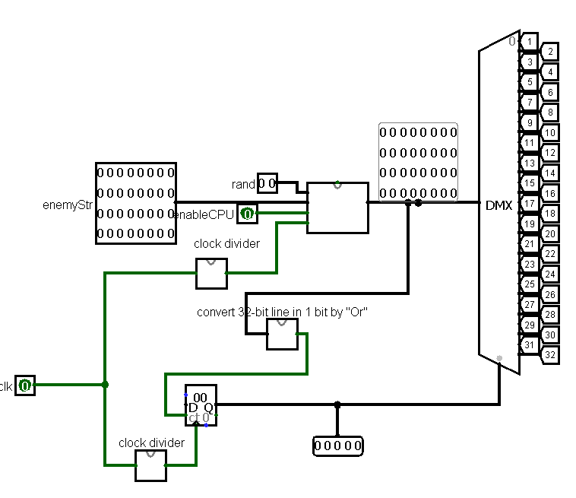
SOME ADDING CIRCUITS

Slide 12
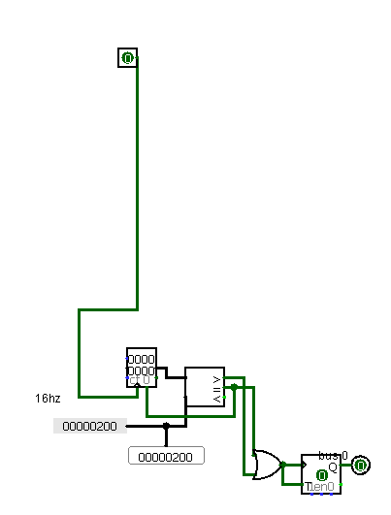
SOME ADDING CIRCUITS

Slide 13
POSSIBLE OUTCOMES OF THE GAME
Player can win or lose the game, the result depends on his movements and shooting. Player has to destroy all the enemies before they reach him and at the same time to avoid enemies bombs to win the game. If an enemy shooted the player up, then player lost, also if enemies reached the player.

Slide 14
CONCLUSION
In conclusion all the chosen goals was completely achieved and the game was developed by using certain instruments. During the creating of project next skills were learned:
development of logical circuits,
implementation processor into the logical circuit and its programming,
writing technical documentation,
team-building, time-managment and so on,
presentation of a project.

Slide 15
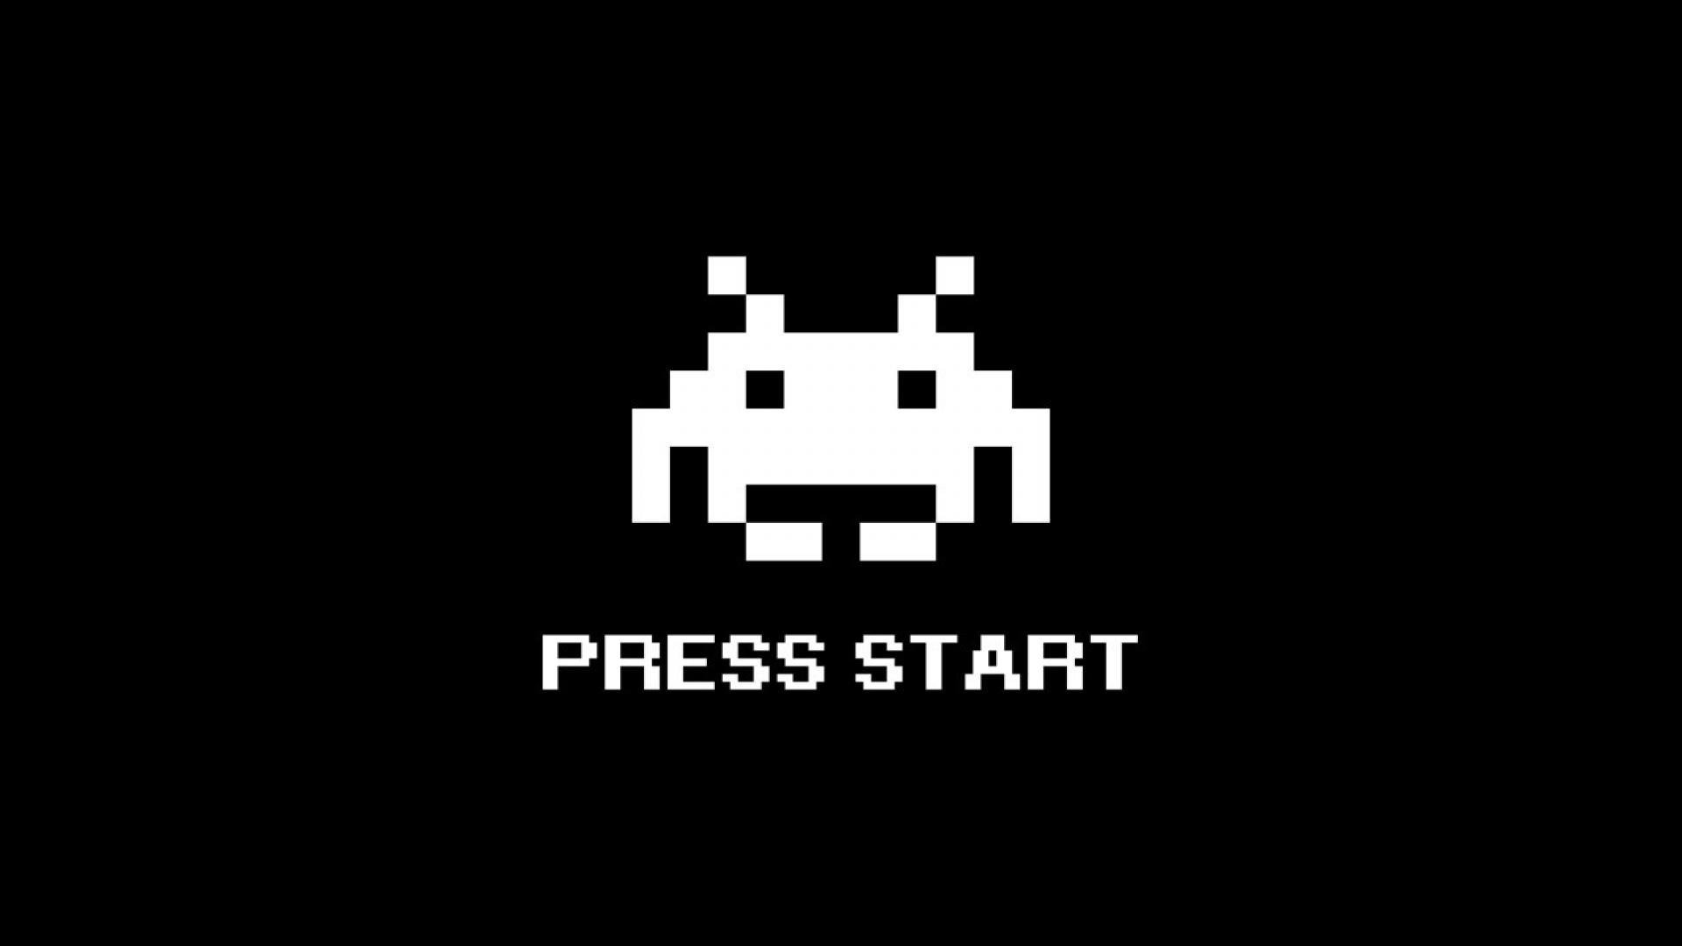
THANK YOU
to pay respect
FOR YOUR ATTENTION!

